Slide 1
Category review: Chips
June 2020
Retail Analytics
Brand note: If client logo is not required, use alternate title page layout right click slide thumbnail > Layout > Title

Slide 2
Notes:
To view Privacy video explaining how important data privacy is to Quantium, please click here: https://www.youtube.com/watch?v=Zq1QDAkoRzU
or here Q:\Company Reference\Brand & Design\Brand videos\Q Privacy.mp4
At Quantium, we believe that data is the behavioural footprint of humanity and that it has to be treated with the utmost care and responsibility.
Histories, attitudes, indeed lives are stored within it in ways that aren’t always apparent – and that’s what makes its potential so powerful.
To work with it responsibly, sensitively, we set ourselves the highest data privacy protection and governance standards.
We have spent 17 years perfecting privacy-by-design and secure-by-design principles. Central to this is not holding any personally identifiable information about people –
we neither receive it, and put the necessary protections in place to be unable to decipher it.
Every aspect of handling data is safeguarded: from its de-identification, to its encryption – data security is paramount and of the highest grade.
We pride ourselves on gaining the trust of iconic organisations around the world through years of securely working with their data,
and in turn the trust that builds with their stakeholders.

Slide 3
Executive summary
01
Task 1
The customer segments that contribute most heavily to chip sales are: `Budget - older families`, `Mainstream - young singles/couples`, and `Mainstream - retirees`.
Higher sales from more customers is applicable for `Mainstream - young singles/couples` and `Mainstream - retirees`
Higher sales from more units of chips being bought per customer is applicable for older and younger families in general
Average price per unit chips bought greater for mainstream midage and young singles/couples compared to other customer segments in the same life stage with differing premium customer status
Mainstream, young singles/couples tend towards Kettle brand chips and lower pack sizes
02
Task 2
Trial stores have displayed significant improvement in performance compared to their control stores.
For trial stores 77, 86 and 88, the control stores 233, 155, 237 respectively have been found.
Personally created results conflict with the given conclusion, where store 167 provided the best control score for trial store 77, store 229 provided the best control score for trial store 86, and store 201 provided the best control store for trial store 88.
Had issues adjusting how much impact correlation should have on final score

Slide 4
01
Category

Slide 5
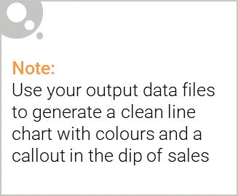
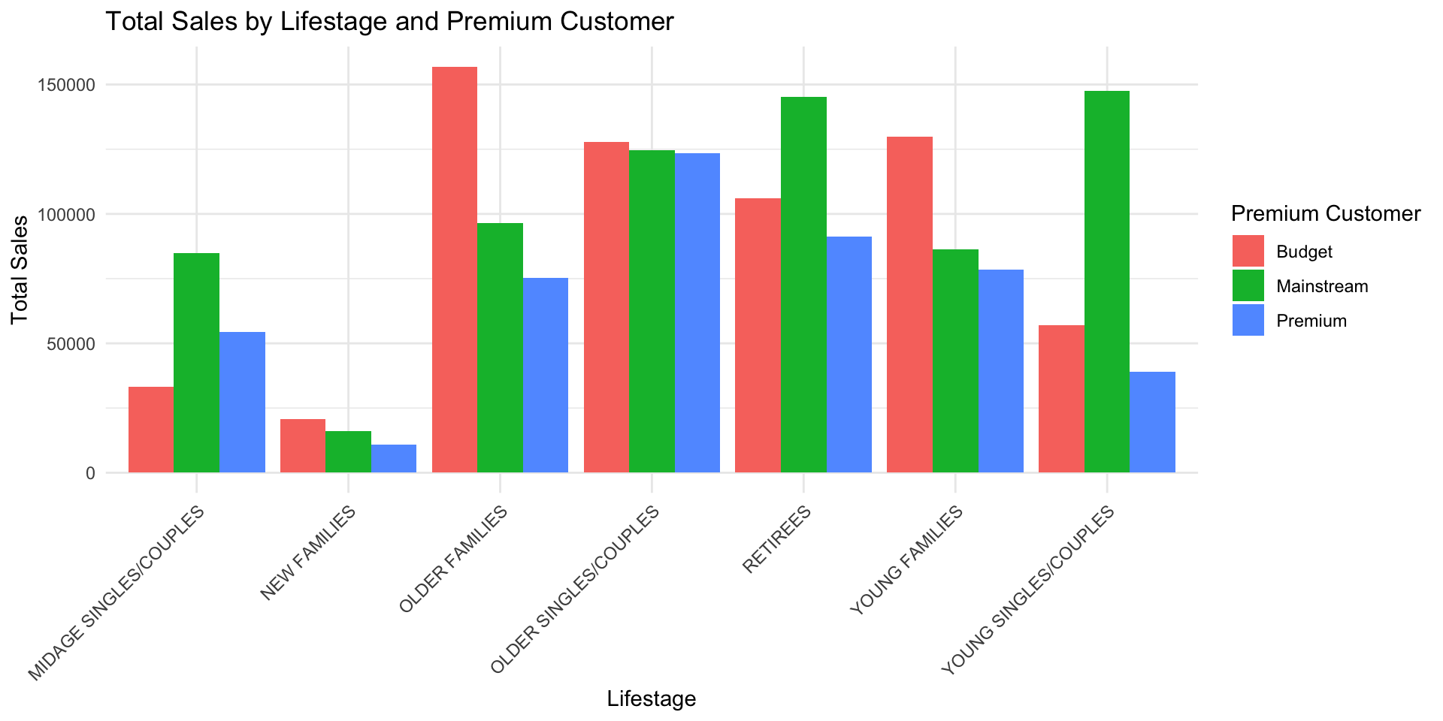
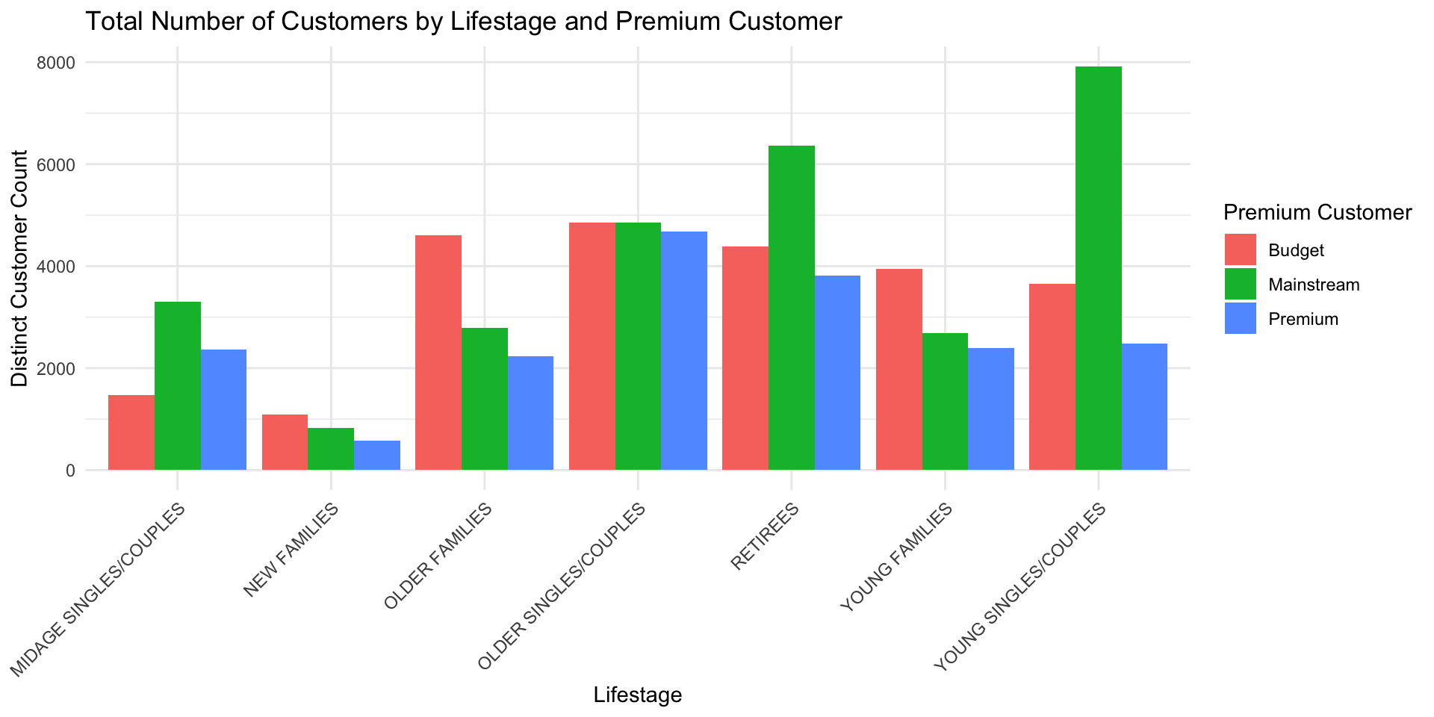
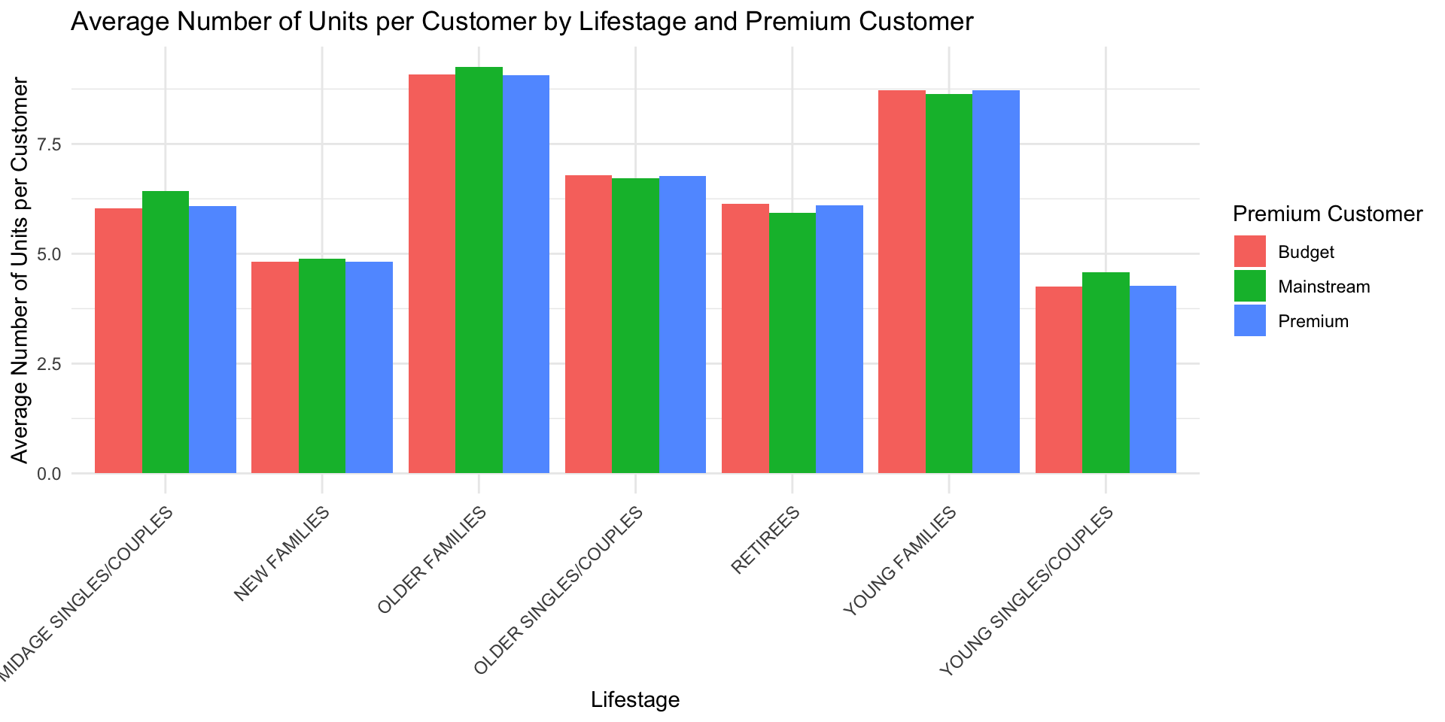
Overview: The customer segments that contribute most heavily to chip sales are: `Budget - older families`, `Mainstream - young singles/couples`, and `Mainstream - retirees`.
`Mainstream - young singles/couples` and `Mainstream - retirees` have particularly high numbers of customers, with at least 6000 customers each, implicitly leading to higher sales from more customers.
Older and younger families tend to have higher values of units of chips bought per customer compared to their midage or newly established counterparts, and compared to singles/couples of the same age brackets.

Slide 6

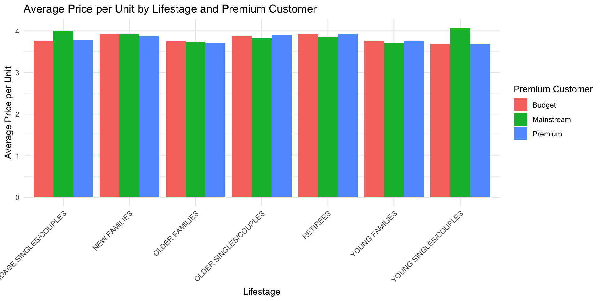
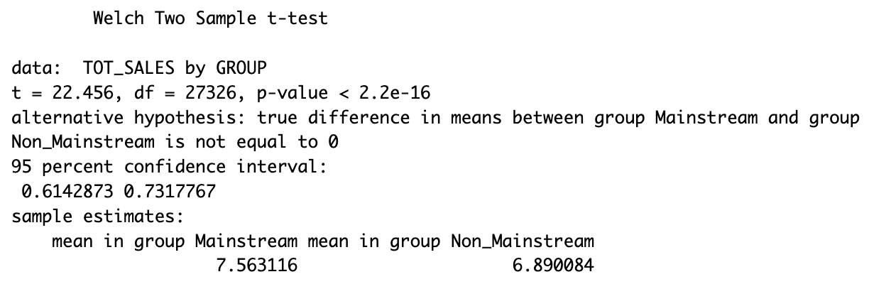
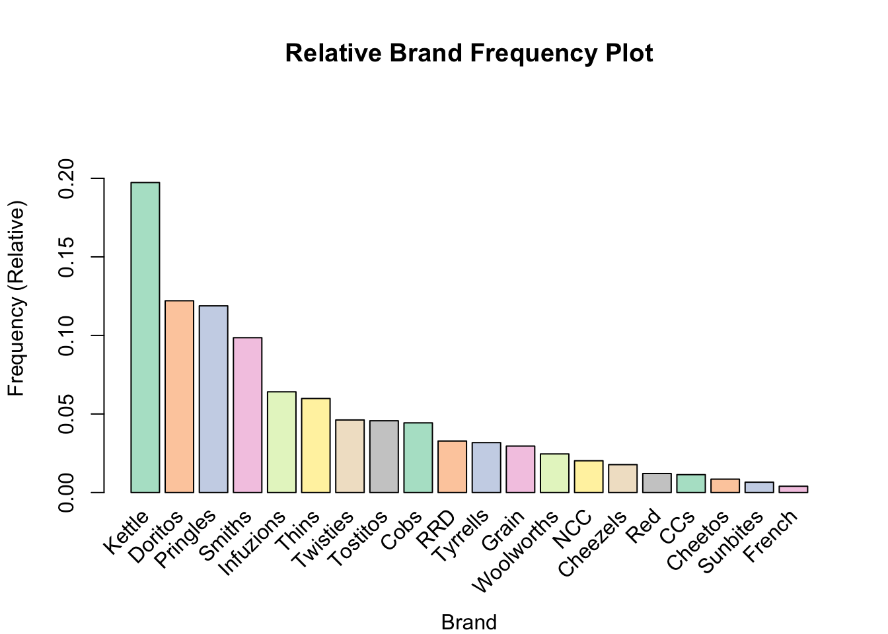
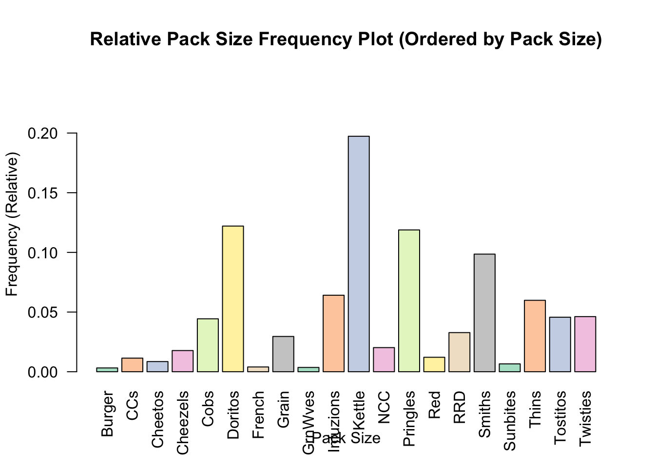
This slide will be commentary on affluence and its effect on consumer buying for the category of chips
Average price per unit chips bought greater for mainstream midage and young singles/couples compared to other customer segments in the same life stage with differing premium customer status
Mainstream, young singles/couples tend towards purchasing Kettle brand chips and smaller pack sizes

Slide 7
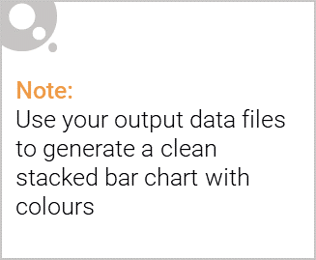
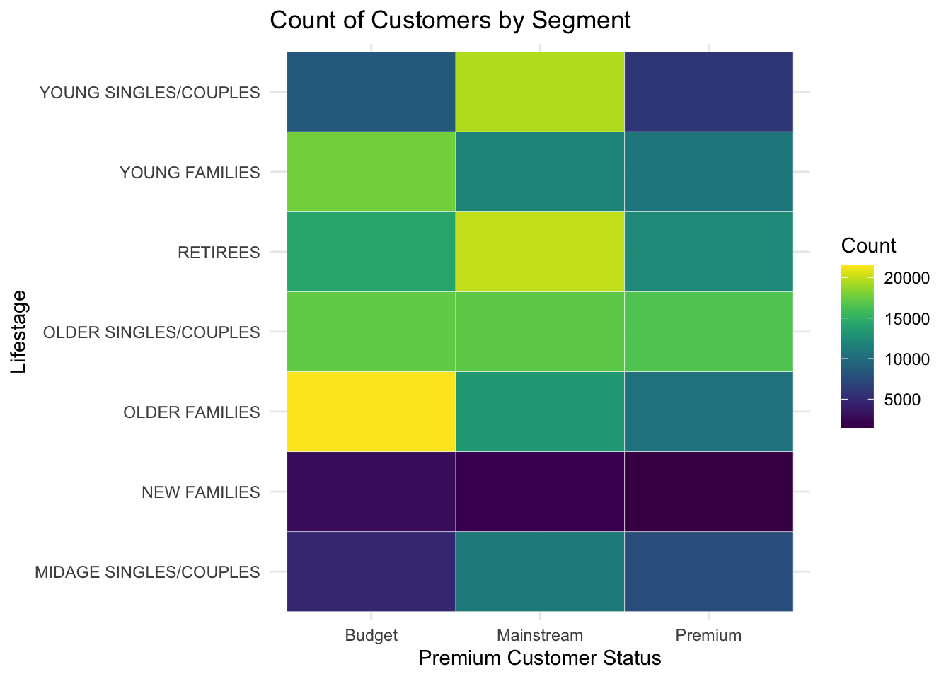
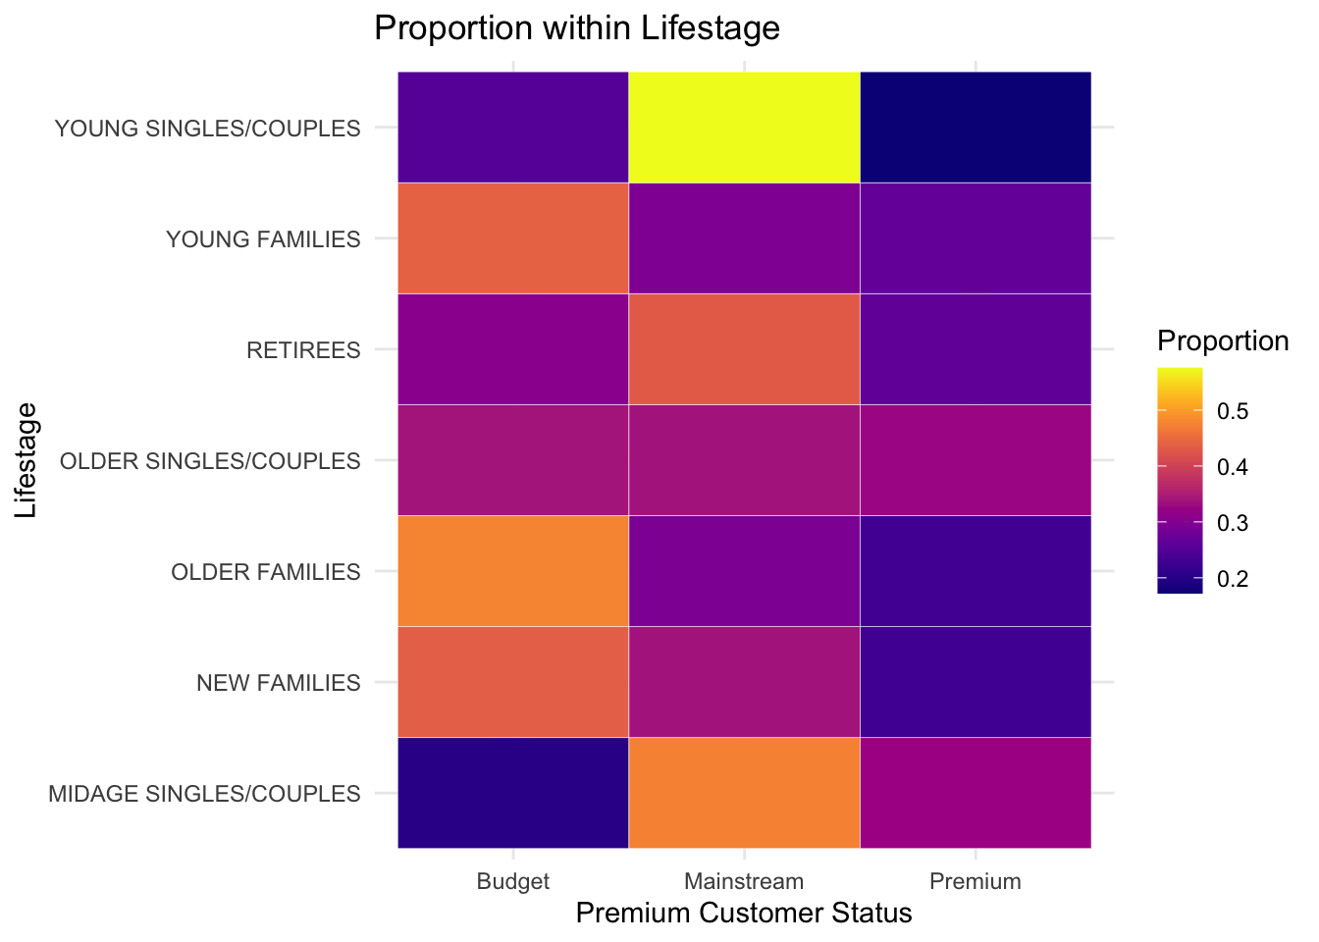
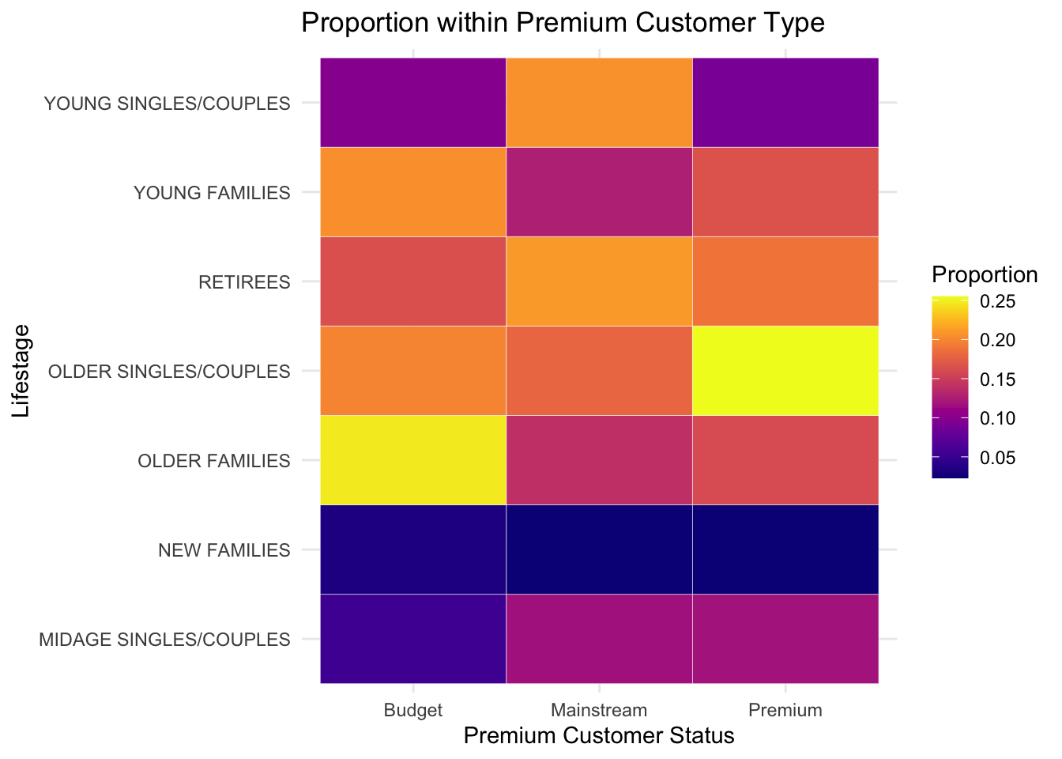
Editable (delete this)
Stretch: Try visualising the proportion of customers by affluence and life stage on this slide
Significantly more customers in older lifestages including retirees, then younger lifestages, then midage singles/couples and new families
Between lifestages, most customers have the Budget status, followed by Mainstream then Premium.

Slide 8
02
Trial store performance

Slide 9
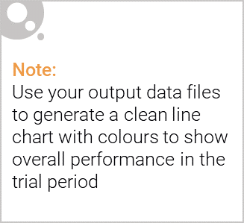
Explanation of the control store vs other stores
Control stores are selected on the following criteria:
They are established stores that are operational for the entire observation period (12 months between July 2019 and June 2019)
Prior to the trial period from February 2019, they are similar to the trial stores in various metrics:
Monthly overall sales revenue
Monthly number of customers
Monthly number of transactions per customer
They provide the second-most optimal ranking from the composite score based on the above metrics, behind the trial store itself.
259 stores have been fully operational in the 12 months between July 2019 and June 2019.
Calculated correlation and standardised magnitude difference of store performance metrics (sales and number of customers) with that of trial store, applied certain weights into each performance metric, then obtained average of performance metric as ranking.

Slide 10
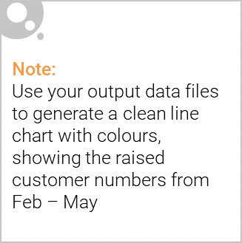
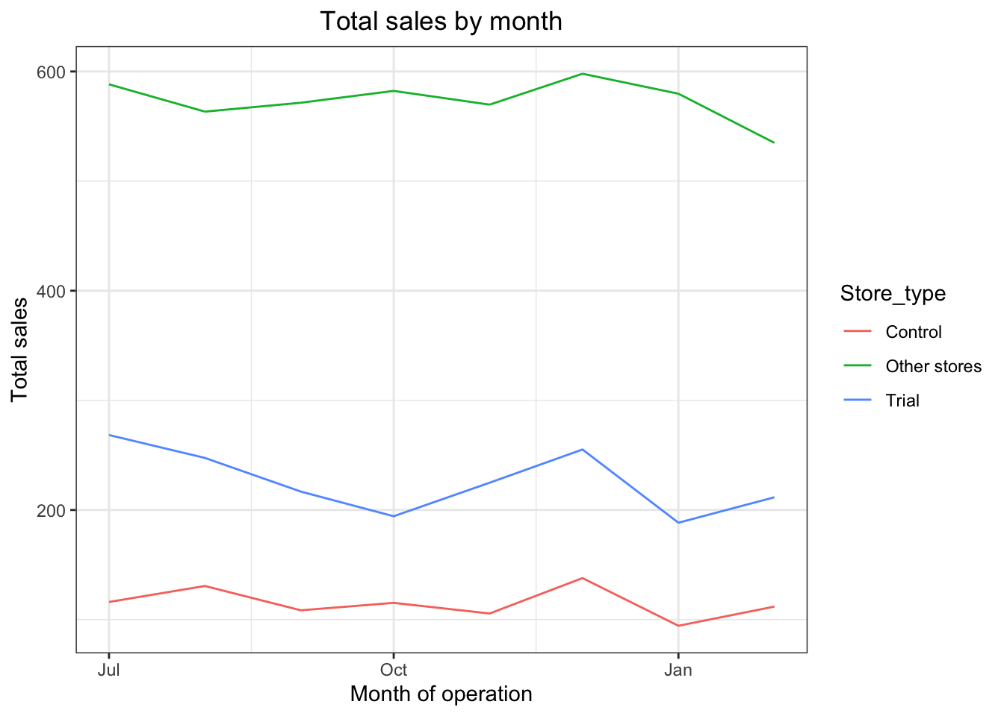
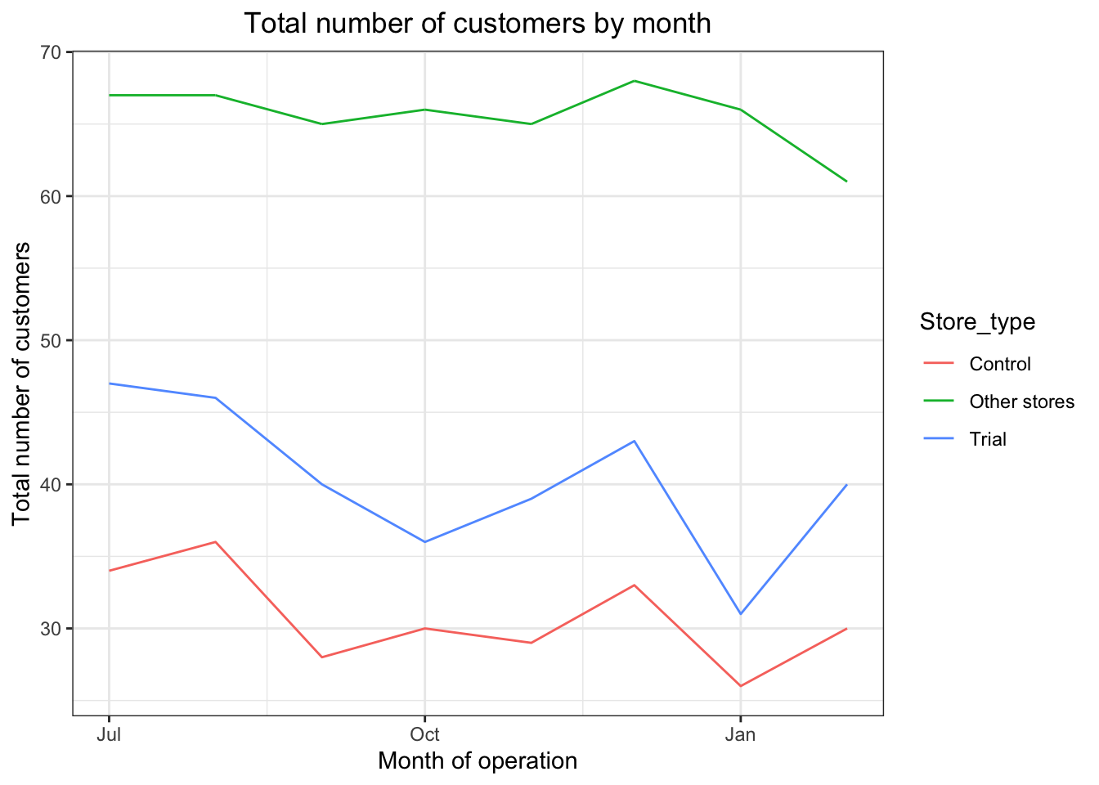
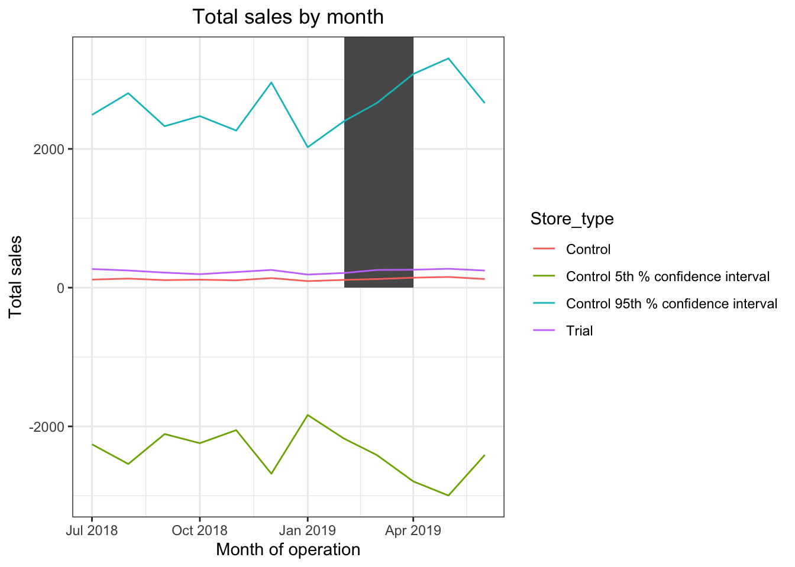
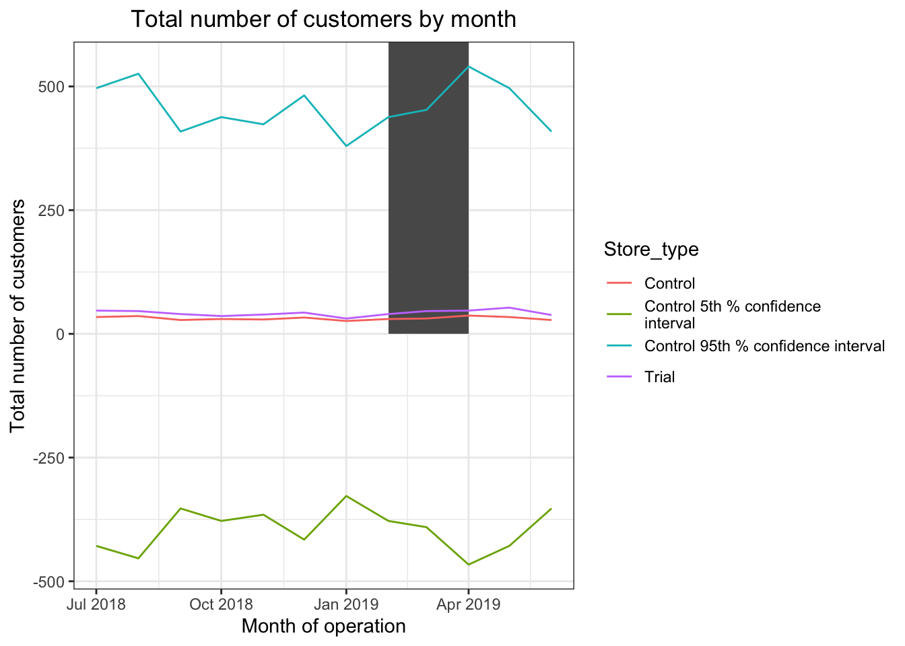
Call out of the performance in the trial store, determining if it was successful
Issues with magnitude metric due to ambiguity of how much weight should be applied for correlation compared to similarity in magnitude.
Initial results of correlation weight of 0.5 resulted in results that did not match well with suggested control stores.

Slide 11
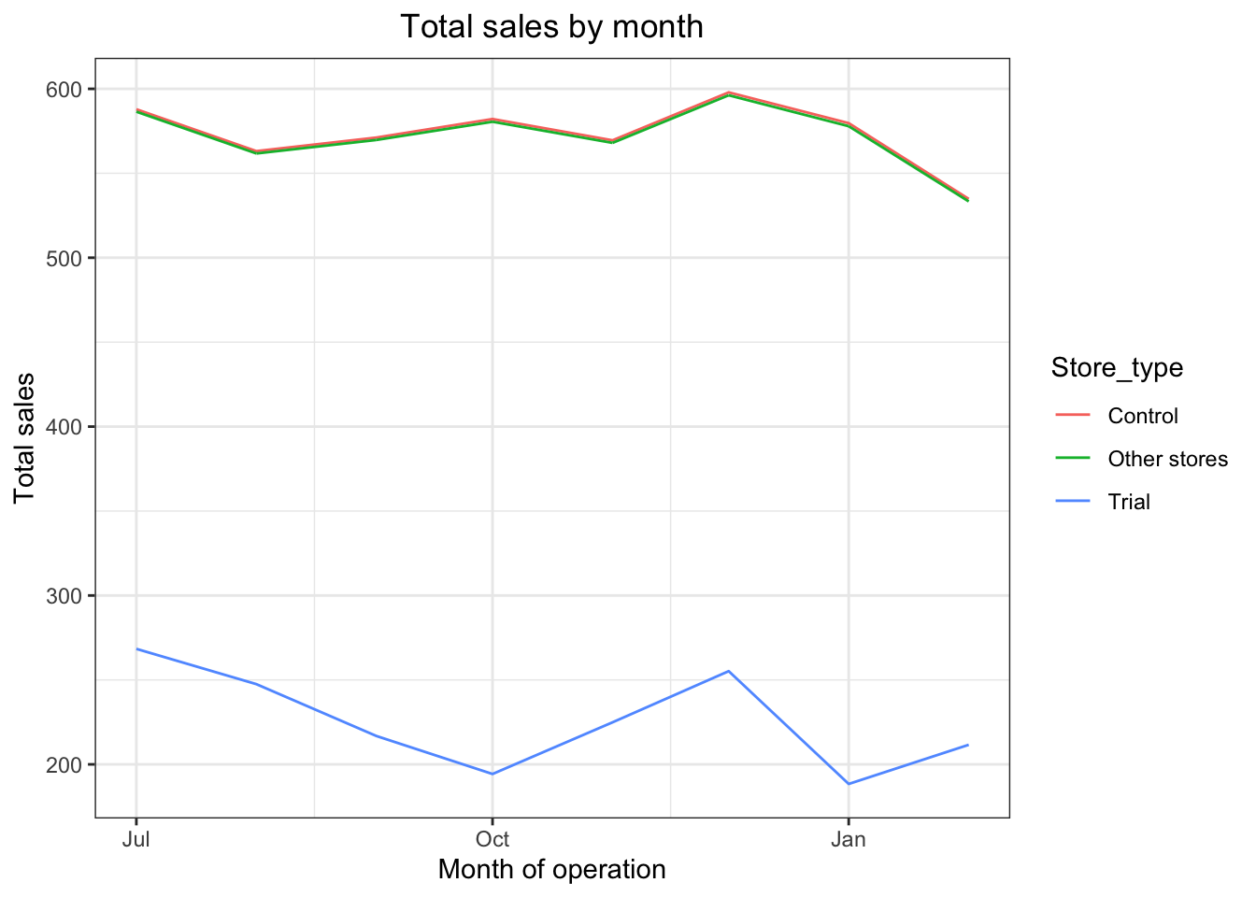
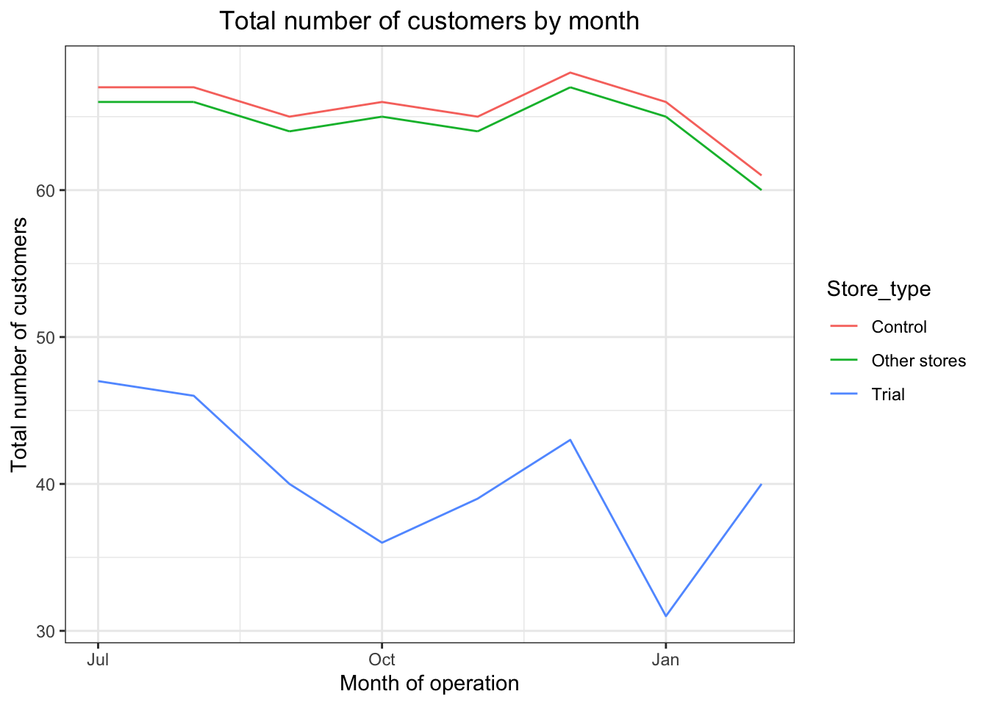
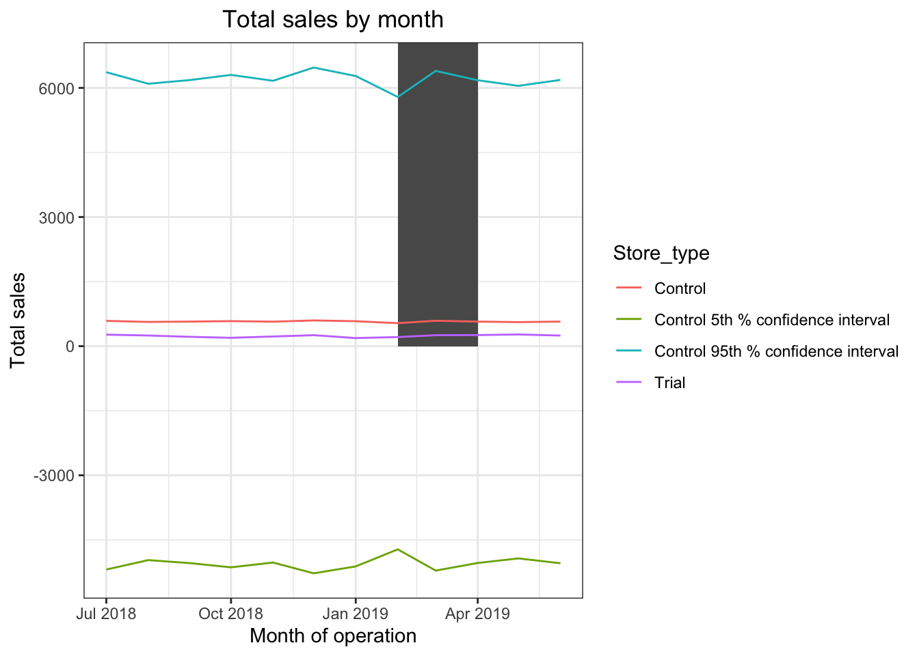
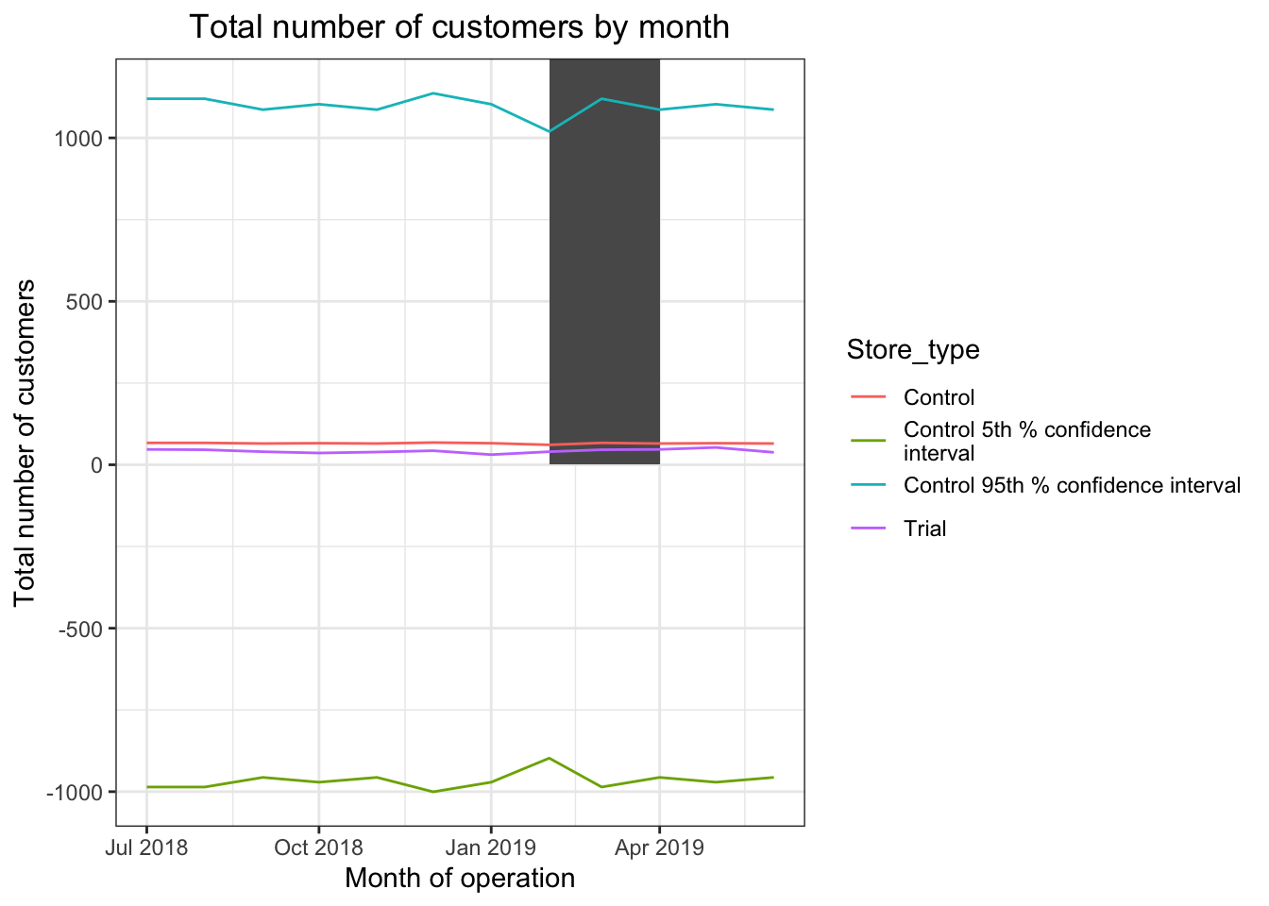
Call out of the performance in the trial store, determining if it was successful
t-value is much larger than the 95th percentile value of the t-distribution for March and April.
Trial in store 77 is significantly different to its control store 233 in the trial period, as the trial store performance lies outside the 5% to 95% confidence interval of the control store in two of the three trial months.
Same applies for trial store 86 with control store 155, and trial store 88 with control store 237.

Slide 12
Future considerations
Focusing on the customer segments `Budget - older families`, `Mainstream - young singles/couples`, and `Mainstream - retirees` would be beneficial to business.
Given the `Mainstream - young singles/couples` and `Mainstream - retirees` groups provide most sales from large quantities of customers, improved accessibility of the stores could be beneficial.
Decreasing the price of chips, especially Kettle brand chips, for older and younger families specifically may encourage them to purchase more chips.
The new trial layouts appear to be effective and should be implemented, though it is uncertain if seasons have an influence on the impact of the trial layout due to the lack of data for different seasons.

